Slide 1
Analyzing Neighborhoods and Recommending an area to start a restaurant in Brooklyn, New York

Slide 2
Introduction
Brooklyn is a borough of New York City, in the American state of New York. It is the most-populous county in the state, the second-most densely populated county in the United States, and New York City's most populous borough, with an estimated residents of over 2 million in 2020.
Although it is New York's most populated borough it has a land area of only 70.82 square miles(183 sqaure km) making it New York's fourth smallest county with respect to land area.Since the 2010s, Brooklyn has evolved into a thriving hub of entrepreneurship, high technology start-up firms, postmodern art and design.
The aim of this project is to recommend a Neighborhood to start a restaurant in this thriving hub that will be self sufficient.

Slide 3
Data
The data used in this project is a dataset downloaded from New York City Department of finance and consists of properties that were sold from January 2020 to December 2020.
The dataset also consists of various columns such as tax class, address, neighborhood, lot number, block number, land square feet and many more in the form of an excel sheet.
Our target Variable in the datasheet is the Neighborhood, Address and zip code as they will be useful to retrieve the nearby venues in order to cluster them.

Slide 4
The second set of data is from the GeoNames website which provides Latitude and Longitude for a given zip code
This dataset contains zip codes of every state in USA along with the geographical co-ordinates and hence had to be filtered to our requirements.
The third Dataset is from Foursquare api which retrieves all the venues, ratings, tips etc for a given location within the given radius.
We can tell if a location is suitable to open a restaurant by collecting and analyzing the most common venues and their characteristics for the said location.
The data from the Foursquare Api is retrieve via a URL which is then unpacked to get all the venues nearby and also photos of the venues if needed.

Slide 5
Methodology
In this project exploratory data analysis is done on Brooklyn, New york to determine which neighborhood is most suitable to start a new restaurant.
First the Brooklyn dataset is cleaned for errors and combined with another dataset containing Co-ordinates for every neighborhood according to the zip codes and visualised.
Then Foursquare Api is used to fetch the nearby venues in every neighborhood and the top most common venues is identified.
The Neighborhood data and the venues data are combined and unsupervised clustering is done by KMeans clustering to get the Neighborhoods with similar venues.
After clustering each neighborhood is examined and analyzed to choose the best cluster to start a new restaurant based only on the other venues in that cluster.

Slide 6
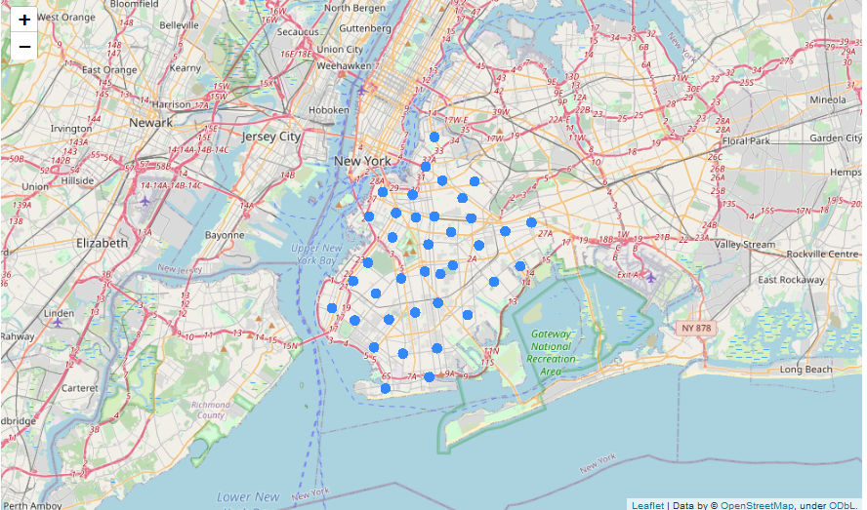
Data Visualisation
Visualising all the Neighborhoods in the data frame using folium

Slide 7
Once the dataset is visualised, Foursquare api is used to get nearby venues to each of the neighborhood.
The result from the api is then converted to a dataframe with decreasing number of most common venue in that area as shown in the next slide.

Slide 8
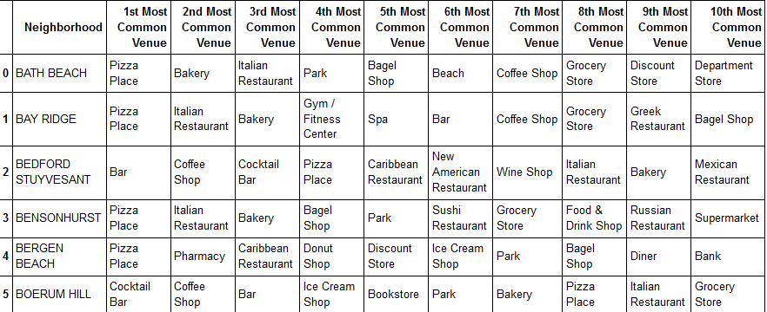
Dataset
After cleaning of the data is done, the following dataset was used for clustering.

Slide 9
Clustering Neighborhood:
Once the Dataset with the most common venues was formed, the neighborhood will be clustered using KMeans.
Kmeans is a type of unsupervised learning algorithm which is somewhat related to K-Nearest Neighbor algorithm.
This algorithm needs the number of clusters to be initialised, but to choose the number of clusters we use a technique called elbow method as shown in the next diagram.
In this method the point of inflection(k=6) of the curve gives a good indication that the model fits best for that value of k.

Slide 10
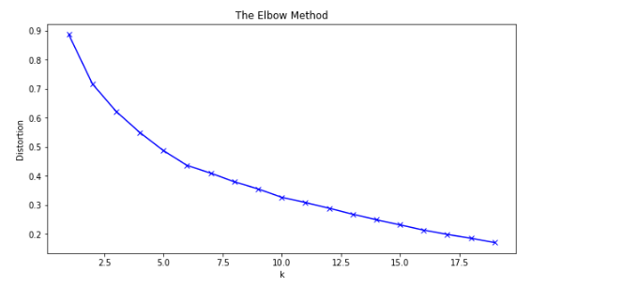
Elbow Method to Determine the best value of K

Slide 11
After the number of clusters is determined, kmeans is applied to the dataset and clustered.
Once clustered we can visualise the data by assigning different colors to different clusters using folium as shown in the next diagram.
These clusters give a good indication about the similarities between the different neighborhoods in the dataset.

Slide 12
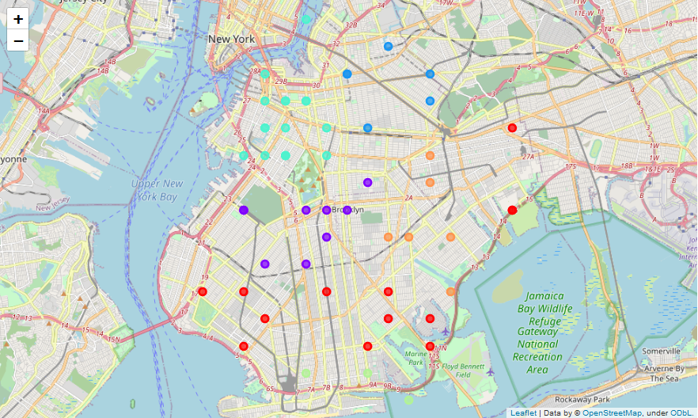
Clustered Neighborhoods

Slide 13
Results & Conclusion:
All the clusters were examined and the neighborhoods in first and sixth cluster are best suited to start a restaurant depending on the new restaurant’s cuisine as the venues in these clusters are mostly made up of either italian or carribean restaurant.
Valuable insights were gained into the venues and popular places in Brooklyn, New york and a better understanding of the diverse places and their influence on a new restaurant.

Slide 14
Thank You

